Slide 1

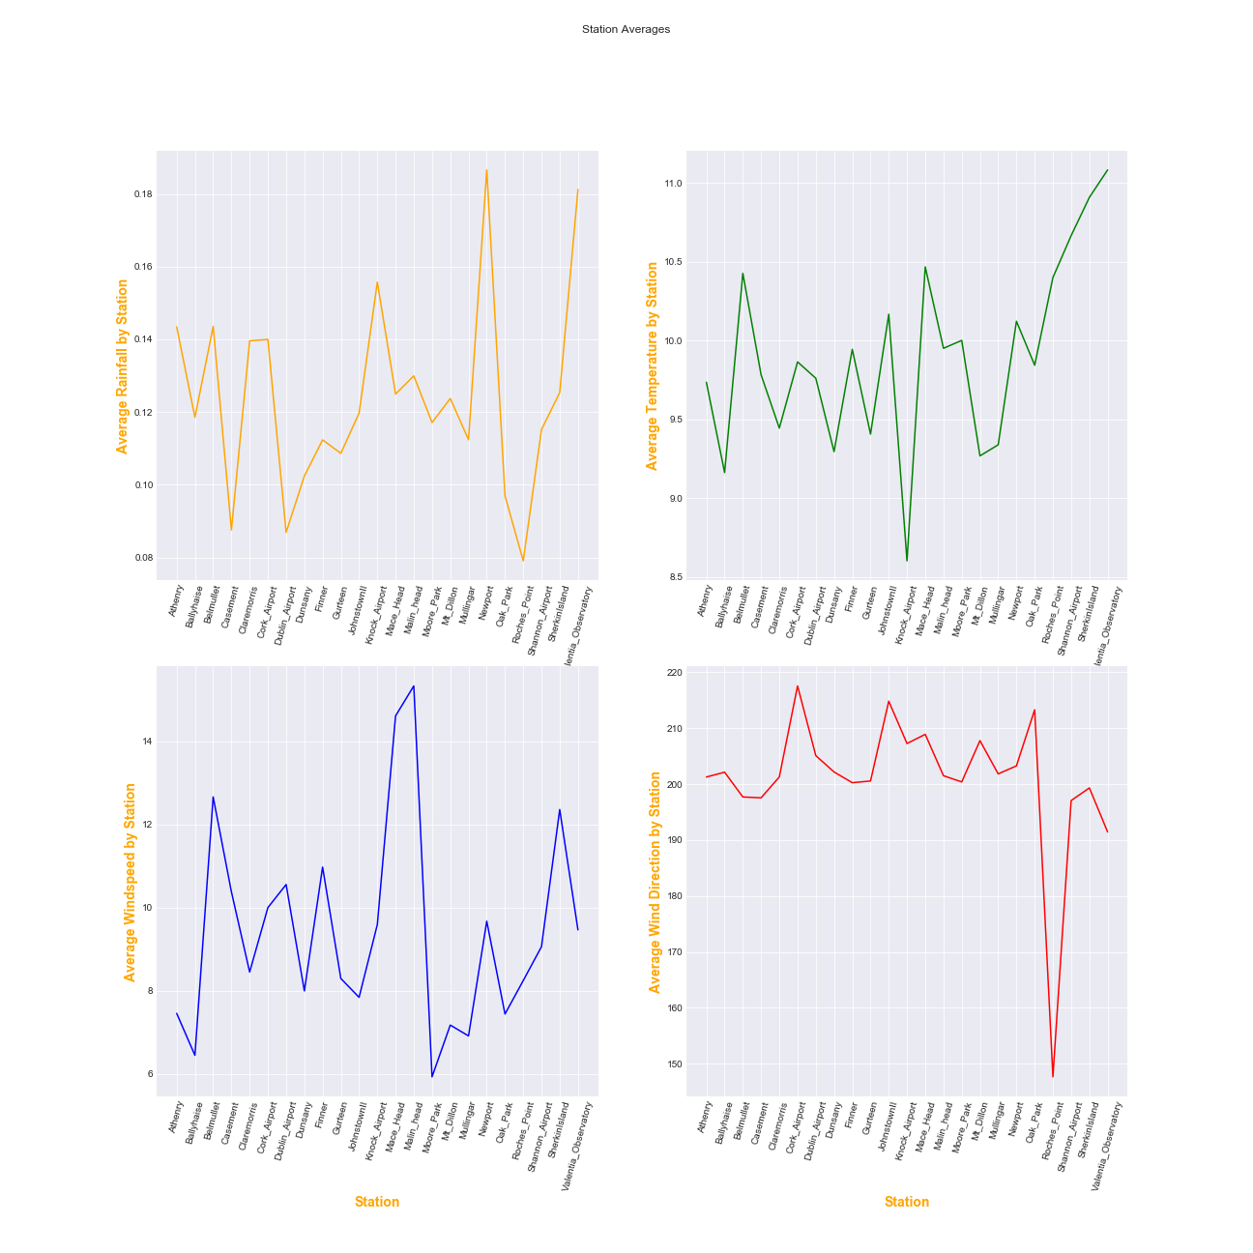
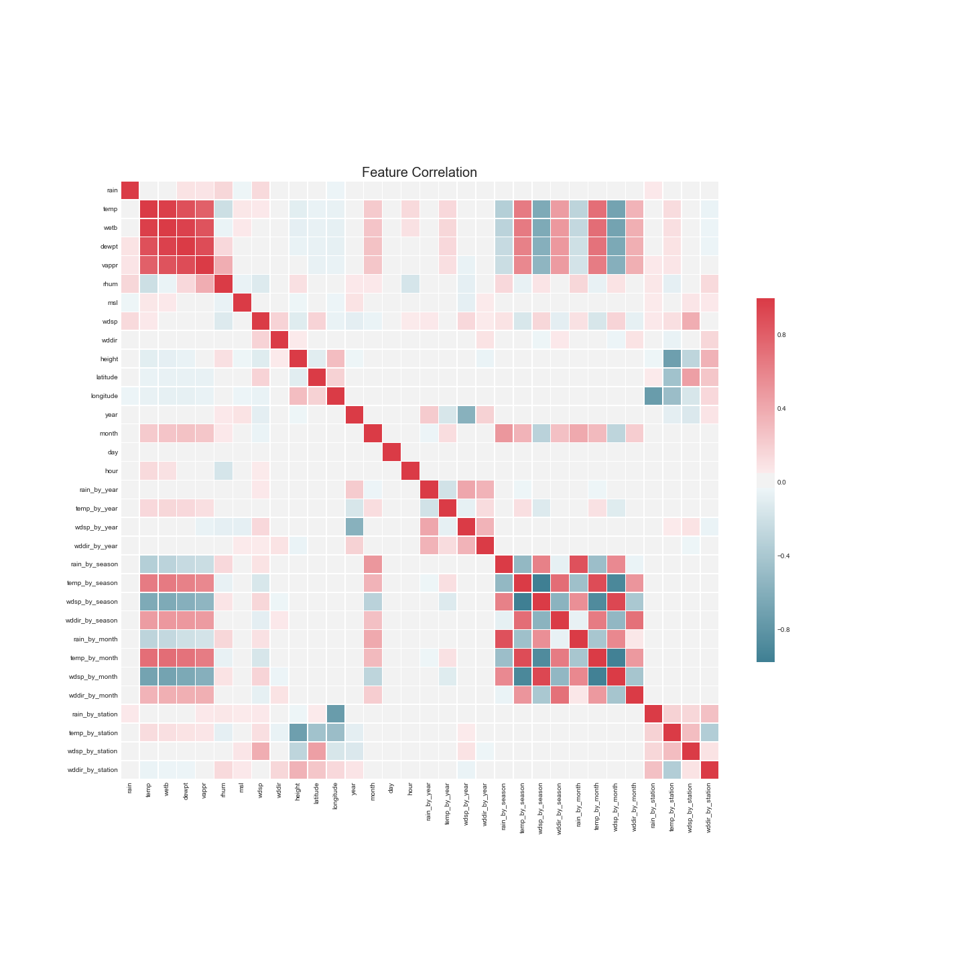
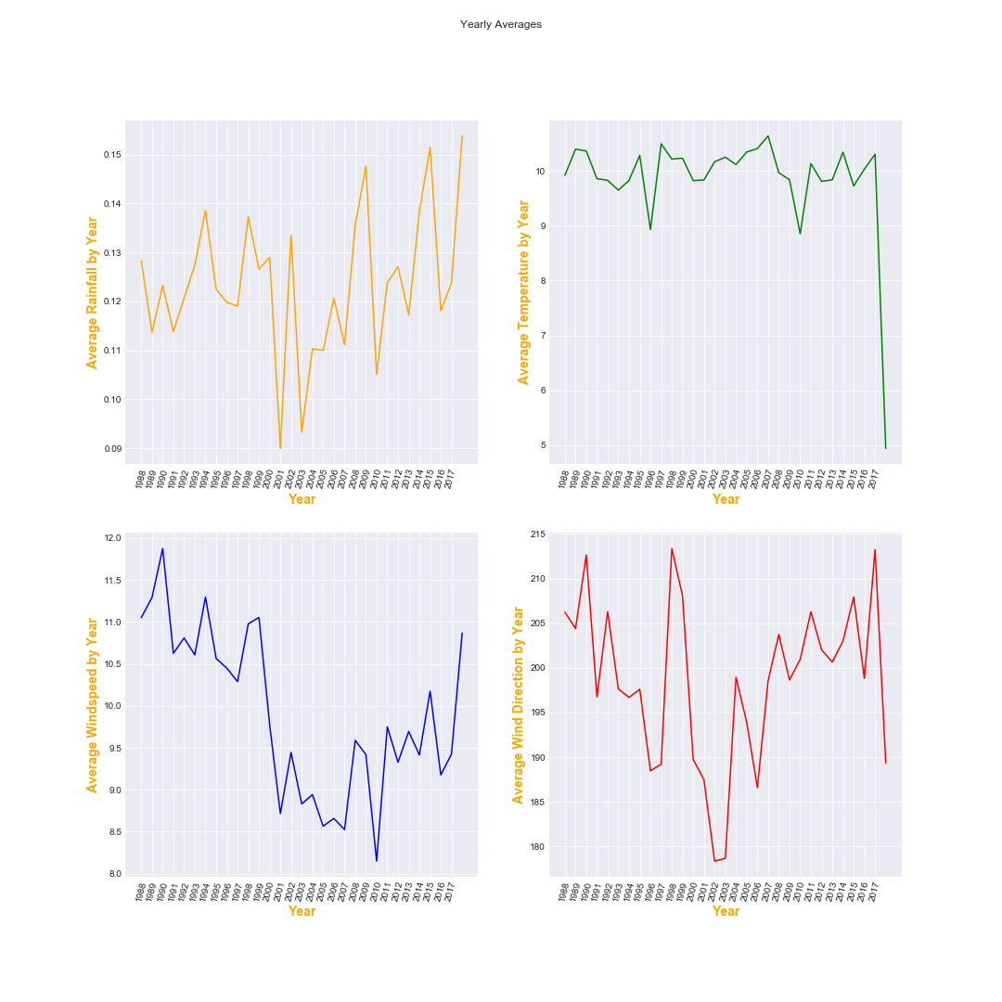
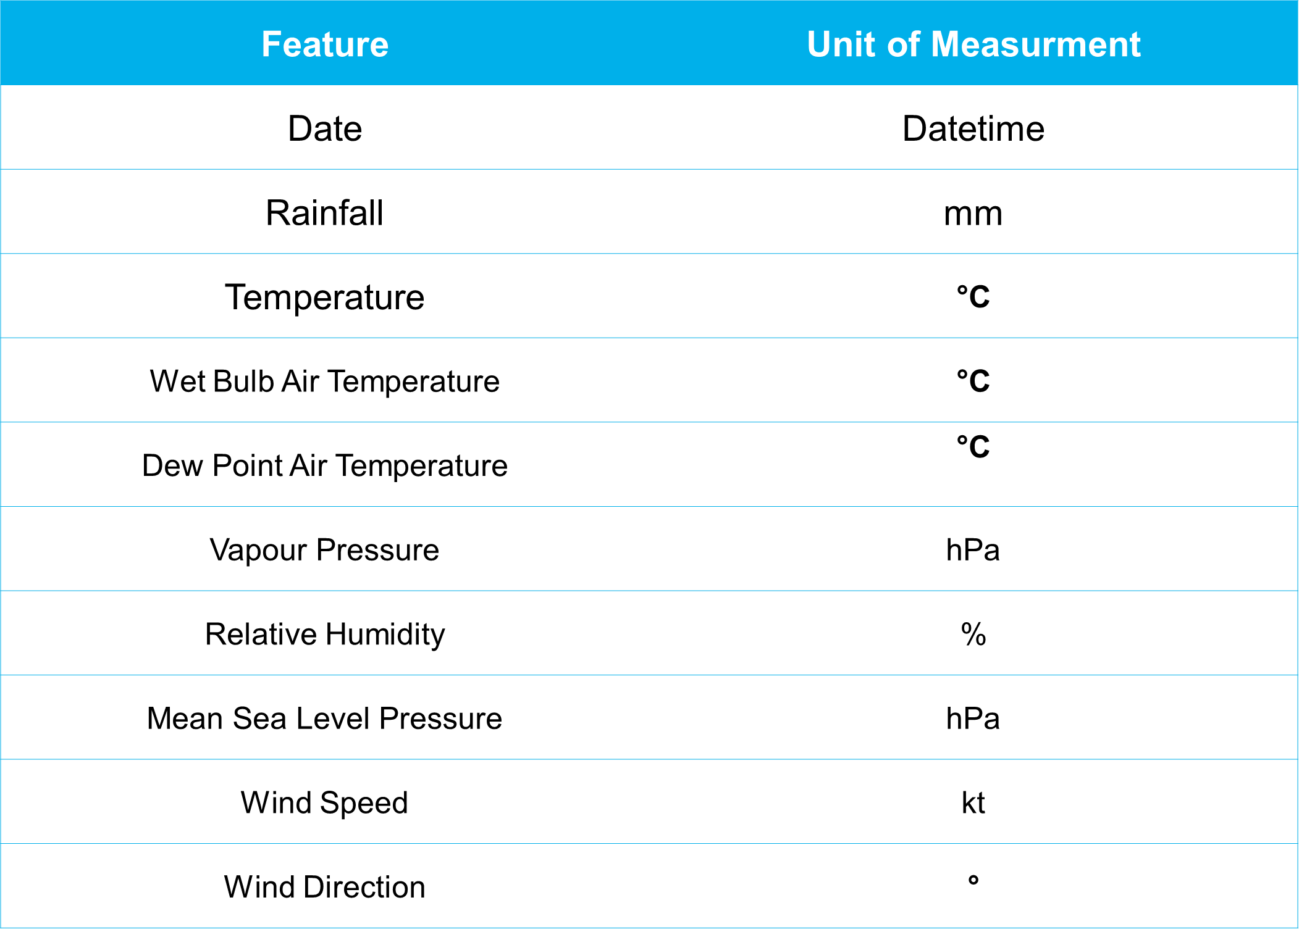
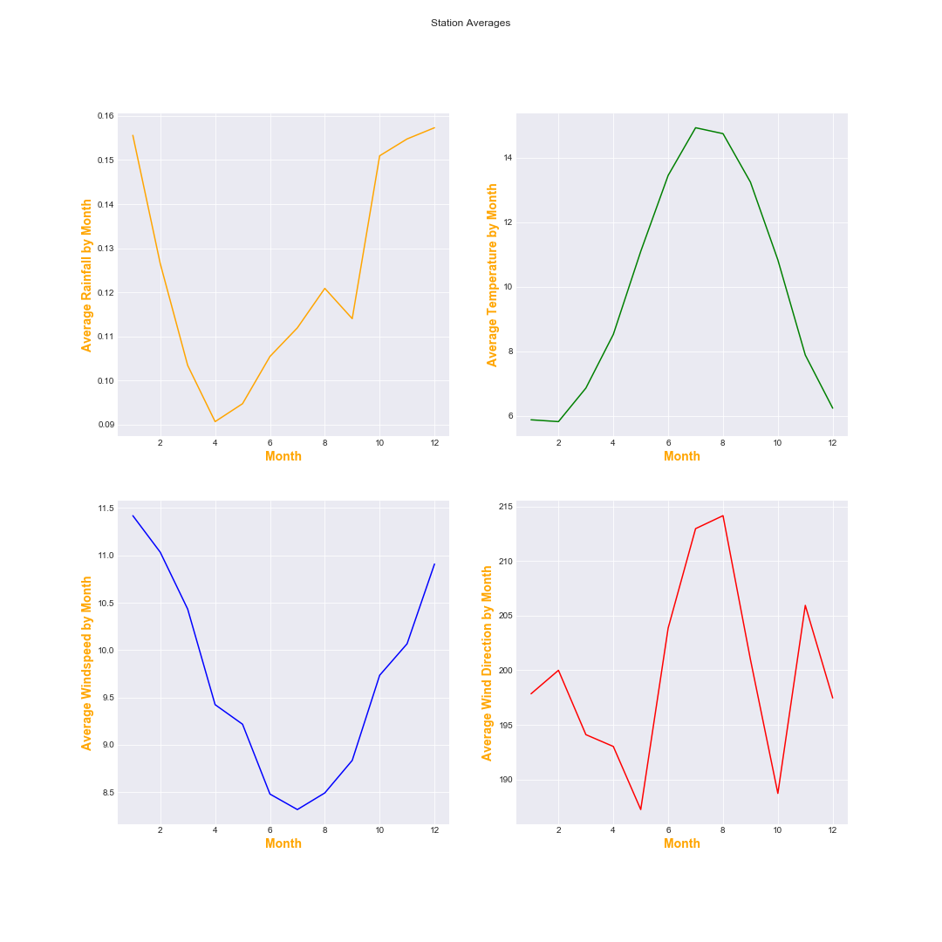
Can Recurrent Neural Networks Improve the Accuracy of Existing Short-Term Weather Prediction Models Implemented Using Machine Learning Algorithms
Student: Gearoid Lacey| Email: gearoidlacey@gmail.com| Tutor: Paul Barry
Research Question
Proposed Technologies
Initial Pre-processing and EDA
Weather prediction potentially useful for wide range of sectors.
Agriculture could benefit greatly.
RNN’s good at predicting time series data.
Could RNN’s improve on existing implementations.
In my opinion, I feel R is more intuitive in terms of performing visualisations. Hence I will use R for visualisations for the remainder of the dissertation.
I will use pandas for all data pre-processing and feature engineering.
I intend to use TensorFlow for creating and training the RNN’s with the possibility of using Keras on top as a high level API.
I plan to use TensorFlow with GPU support and train on a 2GB graphics card.
Currently the data is automatically retrieved and stored in a local MySQL database.
Literature Review (To Date)
Weather reliant industries struggling with the weather more.
Example: Irish Farmers experiencing a fodder crisis this year.
Many existing research predicts one feature only.
This project aims to create a basic system consisting of 4 RNN’s that predicts, rainfall, temperature, windspeed and wind direction.
(Sreenivasa et. al, 2014) propose a system that uses Artificial Neural Networks (ANN’s) to predict wind forecasts. This system uses a form of back propagation.
In theory neural networks should work well on this problem as they perform better on homogenous data.
(Kuligowski and Barros, 1998) compared an ANN using back propagation to linear regression for rainfall prediction.
Linear regression performed better on day-to-day predictions. The ANN was far superior at predicting extreme amounts of rainfall.
Initial Pre-processing and EDA
Briefly inspected data in pandas.
Noticed a significant number of observations missing all data.
As there are so few features, I decided to drop all rows that had more than 2 null values.
This removed approximately 200,000 rows of data.
Following this I performed some basic feature engineering.
The date column was separated into it’s individual components.
Allowed me to observe the effects of different time intervals on the target variables.
Data Source
The data is sourced from Met Éireann.
Data retrieval is automated using the Beautiful Soup and Requests packages in python.
The data comes from 23 weather stations in 14 counties.
Prior to pre-processing, there are approximately 4.1 million rows of data.
Each observation is recorded hourly.
The data ranges from 1998 to March 2018.
What are Recurrent Neural Networks?
One of the best Neural Network architectures for predicting “the future”.
Takes output of previous time step as input to the current time step.
Work well on time series data.
Suffer from vanishing/exploding gradients problem.
They either learn too slowly or too fast. Need to find a good balance.
As its time series data cross validation and data splits are not straightforward.
Data Description
Initial Pre-processing and EDA
Going Forward
Perform extensive literary analysis.
Domain knowledge is key, initially primary focus will be on forecasting models such as HARMONIE (used by Met Éireann) .
Following this my attention will be focused on the fundamentals of Neural Networks.
Based on the previous two points, feature engineering will take a significant amount of time.
Model tuning: neural networks are relatively straightforward to get up and running it’s tuning them that’s difficult.
Sreenivasa, S. C., Agarwal, S. K. and Kumar, R. (2014) ‘Short term wind forecasting using logistic regression driven hypothesis in artificial neural network’, in 2014 6th IEEE Power India International Conference (PIICON). 2014 6th IEEE Power India International Conference (PIICON), pp. 1–6. doi: 10.1109/POWERI.2014.7117710.
Kuligowski, R. J. and Barros, A. P. (1998) ‘Localized Precipitation Forecasts from a Numerical Weather Prediction Model Using Artificial Neural Networks’, Weather and Forecasting, 13(4), pp. 1194–1204. doi: 10.1175/1520-0434(1998)013<1194:LPFFAN>2.0.CO;2.

